Slide 1
Web Development Project
Ekaterina Dul 2102930

Slide 2
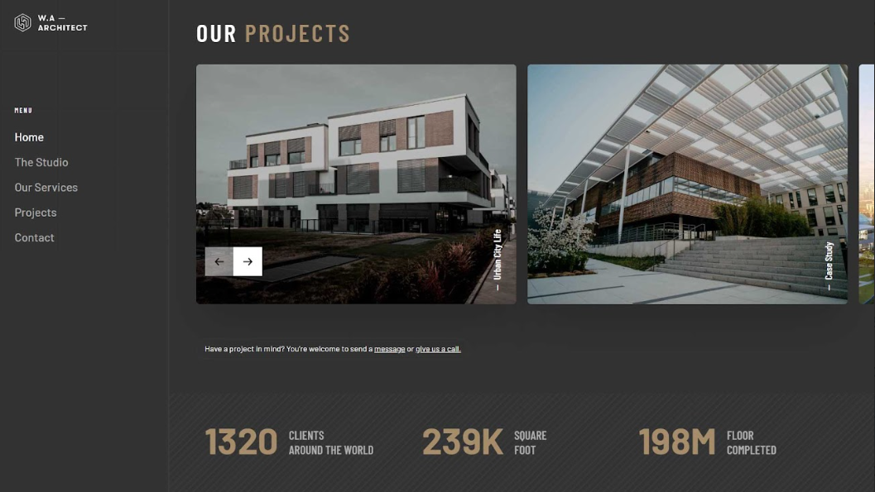
Initial Design

Slide 3
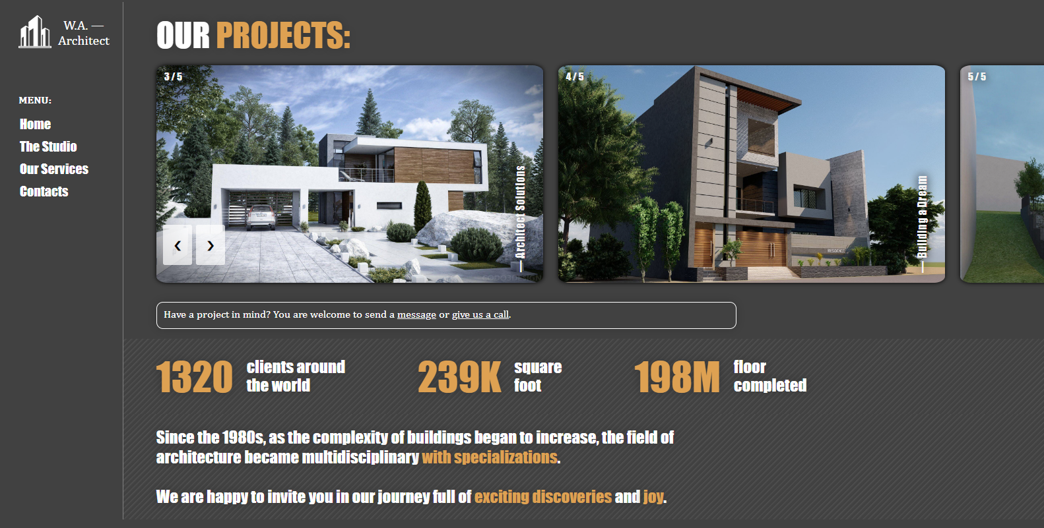
Home Page: Main Result

Slide 4
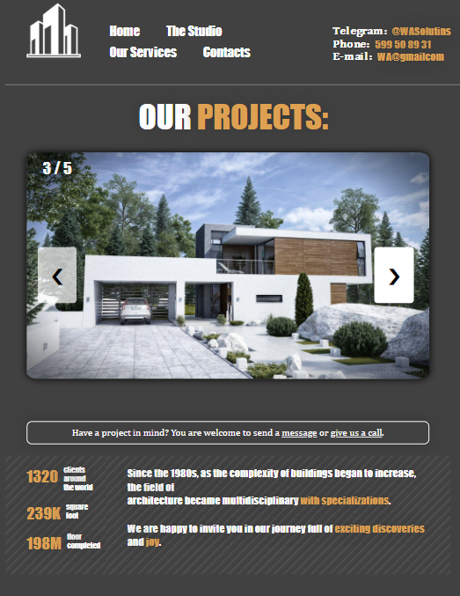
Home Page: Mobile Version

Slide 5
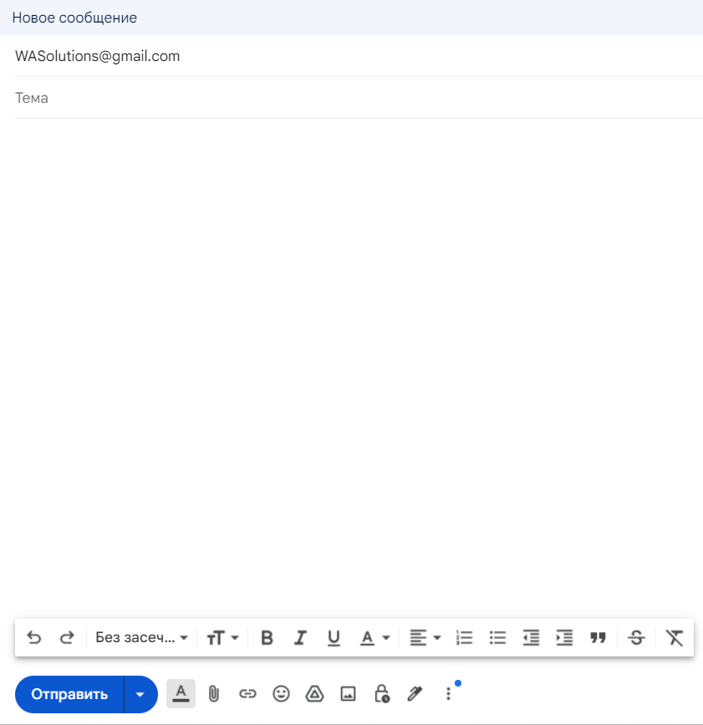
Main Features of Home Page : Contact Links

Slide 6
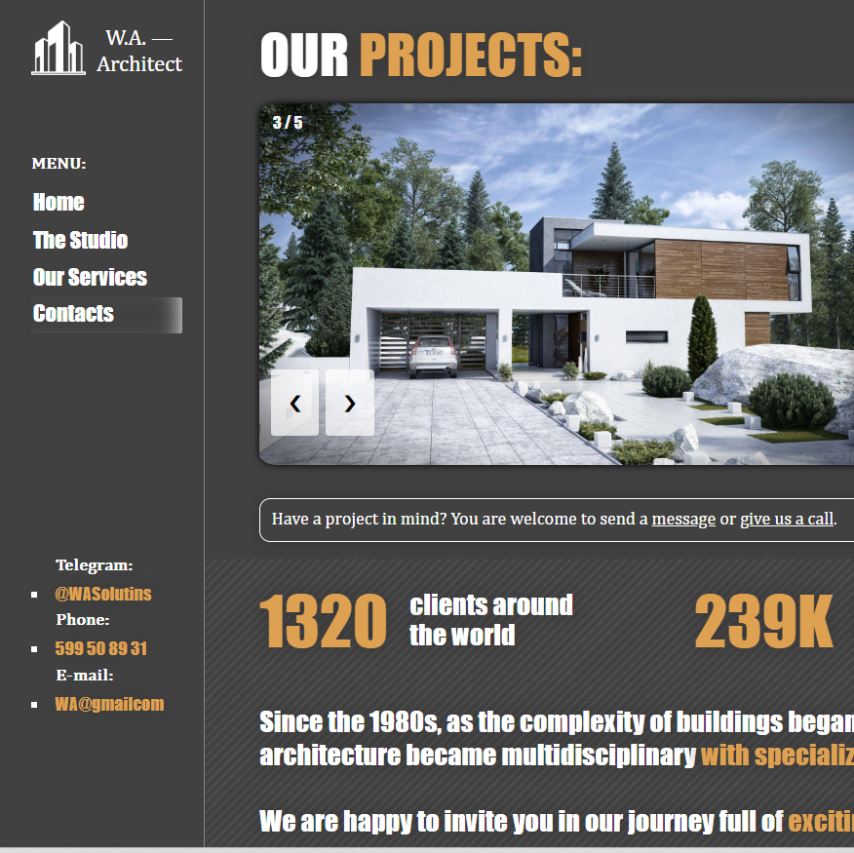
Main Features of Home Page : Contact Section

Slide 7
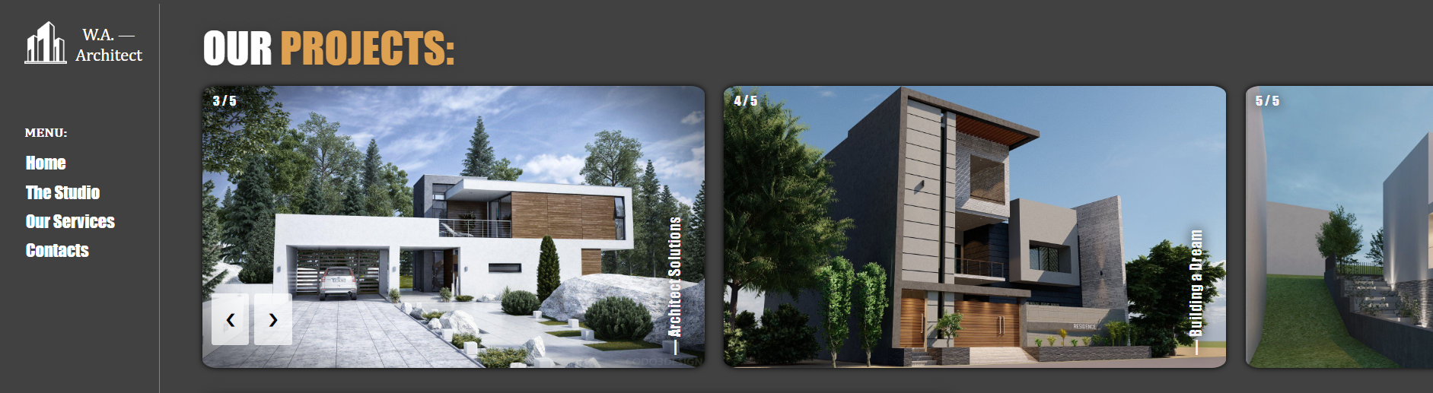
Main Features of Home Page : Slideshow

Slide 8

Services Page: Main Result

Slide 9
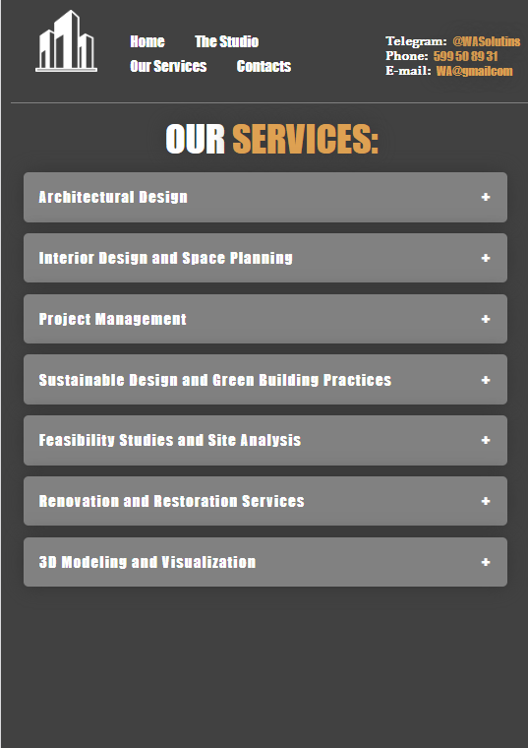
Services Page: Mobile Version

Slide 10

Main Features of Service Page : Accordion

Slide 11

Main Features of Service Page : Gallery

Slide 12
General Project Structure: HTML

Slide 13
General Project Structure: CSS

Slide 14
General Project Structure: Java Script

